Slide 1
Mini-Project Interactive simulation of the composition of forces
Group 24
Members | Student ID
Nguyễn Trọng Nghĩa | 20215101
Nguyễn Văn Nam | 20215097
Phạm Thành Nam | 20194630
Lê Duy Nghiêm | 20215102

Slide 2
01
Problem statement
02
Diagrams
Contents
03
Class Building
04
Demo

Slide 3
Problem statement
Part 1

Slide 4
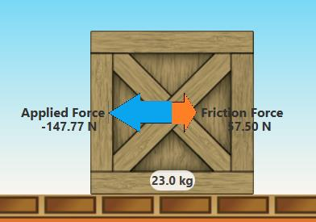
Simple interactive simulation: -> Newton’s laws of motion
User:
Control all components
Observe motion of main object
Display statistics: velocity, acceleration, force value, …
System:
Recalculate statistics each time interval

Slide 5
Diagrams
Part 2

Slide 6
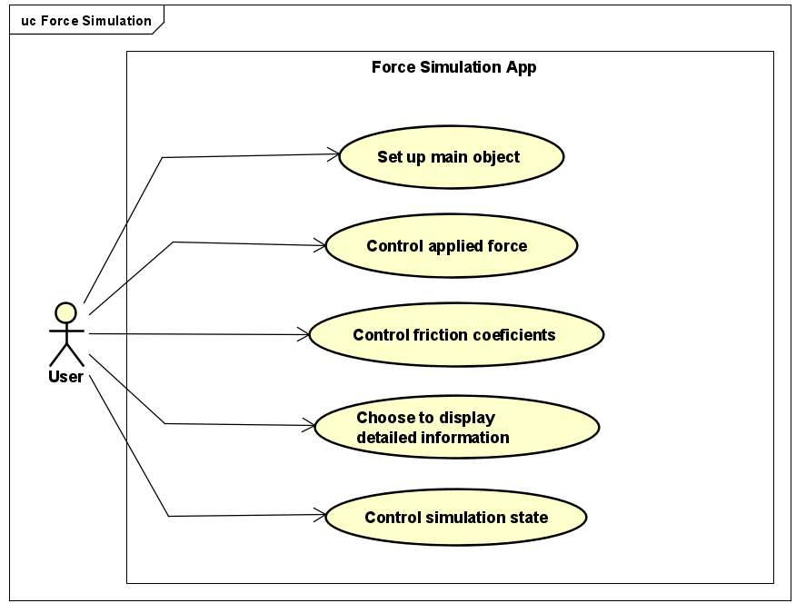
Use case diagram

Slide 7
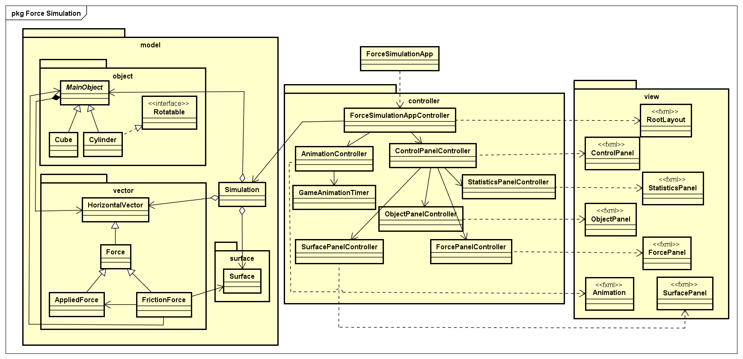
General class diagram

Slide 8
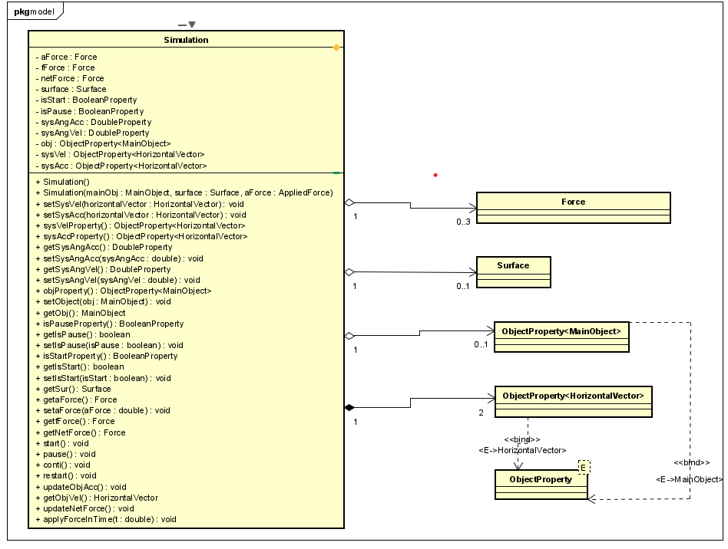
Class diagrams for model package

Slide 9
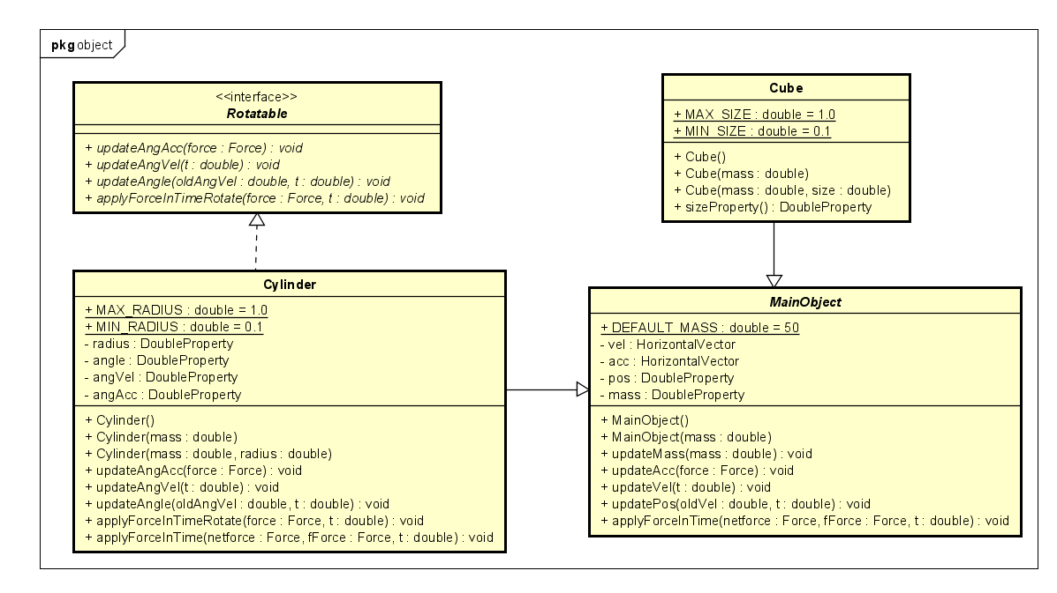
Class diagrams for object package

Slide 10
Class Building
Part 3

Slide 11
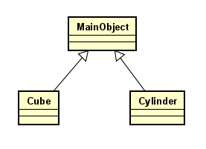
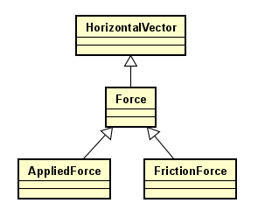
Inheritance
Cube, Cylinder inherits from
MainObject
All Forces inherits from
HorizontalVector

Slide 12
Polymorphism
Different behaviors of applyForceInTime method in different classes
In Simulation class:
public void applyForceInTime(double t) { this.getObj().applyForceInTime(…); }
In Cube class:
public void applyForceInTime(..) { super.applyForceInTime(..);}
In Cylinder class:
public void applyForceInTime(..) {
super.applyForceInTime(..);
this.applyForceInTimeRotate(..);}

Slide 13
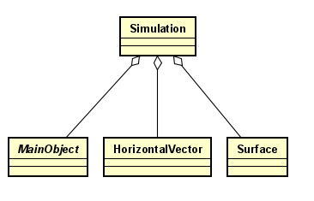
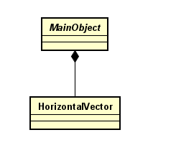
Aggregation vs Composition
Simulation aggregates MainObject, HorizontalVector, and Surface
MainObject composites HorizontalVector (such as velocity, ..)

Slide 14
Demo
Part 4

Slide 15
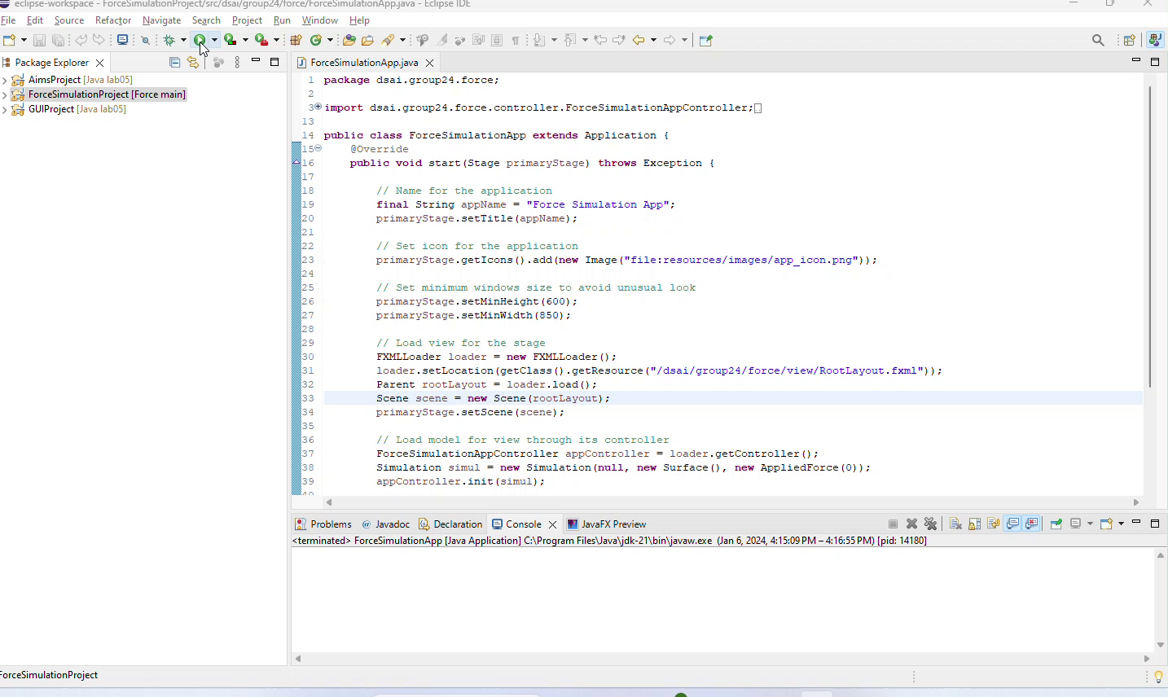

Slide 16
THANKS

